Slide 1

18.5-inch LCD Display Defect Analysis Report --- The LCD Screen is flickering
Presenter: Linda Zhou

Slide 2
CONTENTS
01
Problem Description
02
Technical team formed
03
Temporary measures
04
Cause Analysis

Slide 3
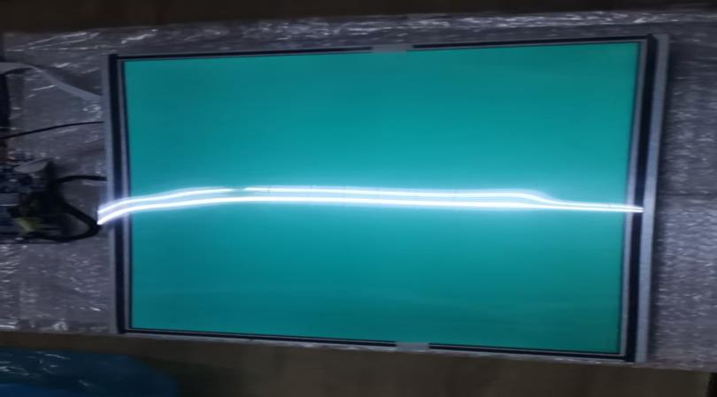
Problem Description
Defect | Screen flickering | Client | Mr. Miguel | Complaint Level | Normal
FG-Code | GV185FHM-N10-3M30 | Location | Spain | Complaint Time | November 15, 2025
Cause Type | Unkown | Rate of Defect | 1pcs | Production Level | Usage Stage
Problem Occurred Location |  |  | □Clients □Market □Factory
Problem Description |  |  | Picture
--On November 15, 2025, HXD received a 18.5-inch LCD Display with a problem of screen flickering as reported by a Client named Mr. Miguel. --On November 16, 2025, using the factory fixtures, we identified defective areas and confirmed that the backlight signal was normal. The screen phenomenon was that the screen has visible screen defects. Note: 1pcs was marked as 1#.
√

Slide 4
Technical Team Formed
Tenical Team
Team Member | Name | Position | Respinsibility
 | Linda Zhou | CS | Customer communication and coordination
 | Jinbo Zhang | OQA | Follow up on on-site analysis and implementation of improvement measures
 | Xiaopan Si | Eng | Further confirmation of defective items
 | Haijian Zou | OQA | Analysis of Defects

Slide 5
Temporary measures
√ Inventory handling: No inventory in the designated batch.
√ Client products: Risk-free, normal production is ongoing.

Slide 6
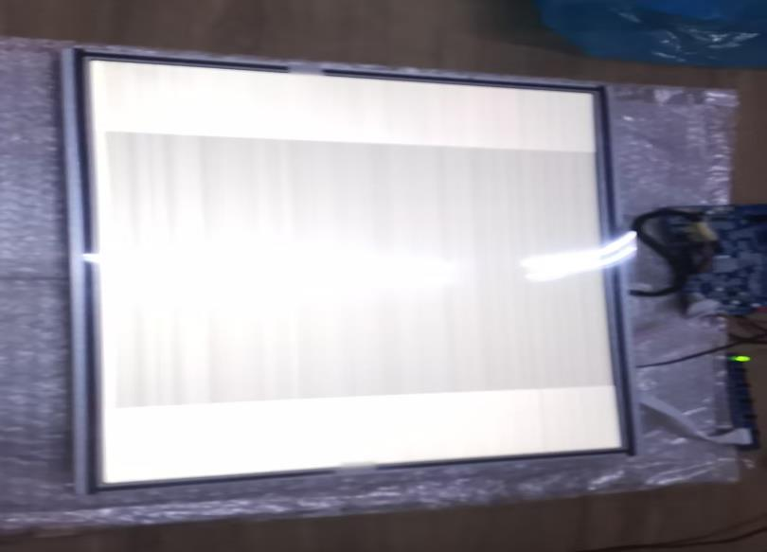
Cause Analysis
□Problem confirmation
By using the fixtures, engineer identified defective areas and confirmed that the backlight signal is normal. The screen phenomenon refers to the display of a flickering screen except for the L0 screen, where all other screens are visible.

Slide 7
Cause Analysis
□Product cycle query
Based on the MDLID information, the production cycle of the product is from September 2024.

Slide 8
Cause Analysis
□Signal ACK
Confirmation of key signal voltages (unit: V)
Confirmation of ground resistance values for each critical voltage (unit: V)
The multimeter test showed that there were no abnormalities in the ground voltages and resistances of all the main signals.
Item | VDD0 | VGH | DVDD | AVDD | VCOM | VGL1
OK | 21.6 | 22 | 3.32 | 12.1 | 4.7 | -8
1# | 22 | 22.1 | 3.3 | 12 | 4.6 | -7.99
Item | VDD0 | VGH | DVDD | AVDD | VCOM | VGL1
OK | 435K | 0.5M | 16.2K | 20K | 1.33K | 31.8K
1# | 432K | 0.48M | 17K | 19.8K | 1.34K | 32K

Slide 9
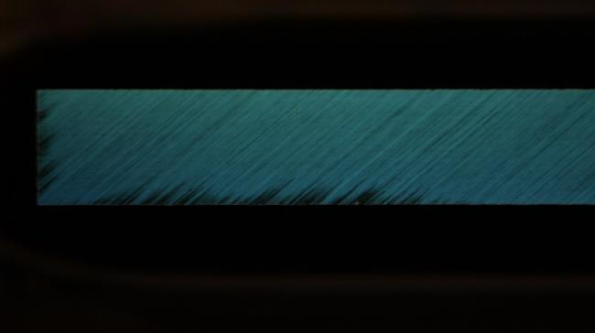
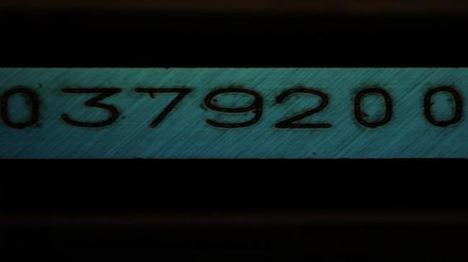
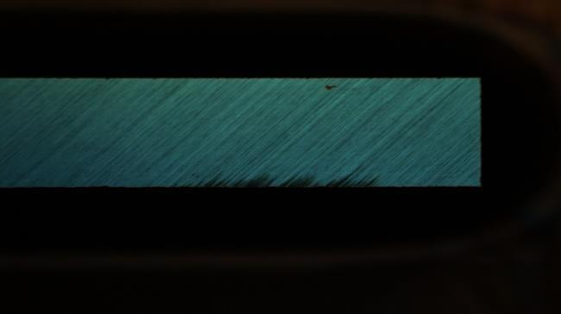
Cause Analysis
□IC appearance verification
Under the microscope, it was confirmed that the defect corresponded to no abnormality in the appearance of the Source IC.
 | Left | Mid | Right
1# Source IC

Slide 10
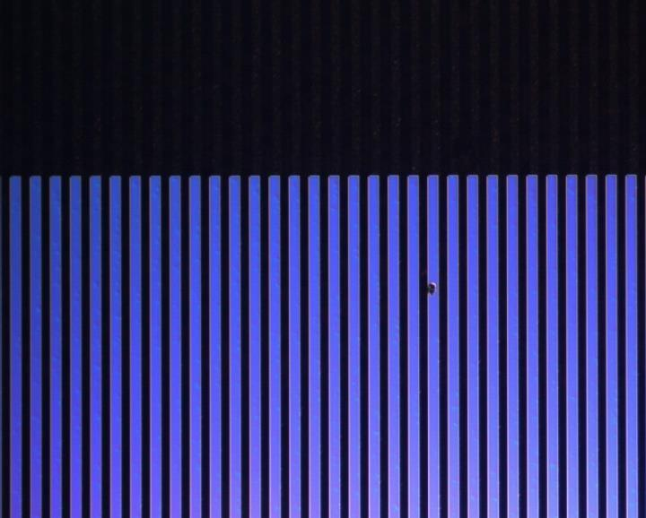

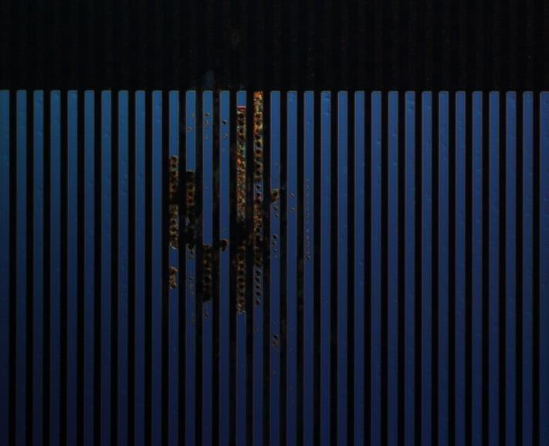
Cause Analysis
□1# Bonding cable confirmation
Under the microscope, the cable was inspected and it was found that there were multiple bumps in the COG bonding area with obvious corrosion, which led to the inability of the signal to continue transmission and caused screen distortion.
 | 1 | 2 | 3
Bonding cable confirmation

Slide 11
Cause Analysis
□Defect cause
In the COG Bonding area of 1#, multiple bumps have obvious corrosion phenomena. The corrosion prevented the signal from continuing to be transmitted, resulting in the display failure.

Slide 12
Ship a new identical LCD display for free, and also repair the original LCD display for free and return it to Mr. Miguel.
Compensation plan

Slide 13
Thank you for trusting HXD
Presenter：Linda Zhou

